Slide 1

Helmet Verify : AI Detection System for Safety Check
BY
Pratham Sherawat (2100681520028)
Aryan Barar (2100681520011)
Vivek Agarwal (2100681520057)
Bachelors of Technology
Department of Computer Science and Engineering (Artificial Intelligence)
Under the Supervision of
Dr. Anamika Singh
Associate Professor
Department of Computer Science and Engineering (Artificial Intelligence)
Meerut Institute of Engineering & Technology, Meerut
DR. APJ ABDUL KALAM TECHNICAL UNIVERSITY
(Formerly Uttar Pradesh Technical University)
Lucknow
(December,2024)

Slide 2
OUTLINE
Introduction
Literature Review
Research Gap and challenges
Aims and Objectives
Project Flowchart
Model Flowchart
Research Methodologies
Summary
Utilization of Research
Result
References

Slide 3
Introduction
The presentation focuses on a Helmet Detection Model using Deep Learning.
Objective: To detect helmets in real-time leveraging deep learning algorithms and computer vision techniques.
Applications:
Suitable for highways and crowded areas.
Enhances the safety of drivers and passengers.
Purpose: To contribute to traffic safety by ensuring helmet compliance.

Slide 4
Literature Review
Deep learning algorithms are effective for object detection and recognition in images and videos.
These algorithms can be applied to traffic safety for real-time helmet detection.
Impact:
Helps reduce road accidents.
Ensures the safety of both drivers and passengers.

Slide 5
Research Gap and Challenges
Despite their potential, deep learning algorithms face challenges in traffic safety applications.
Key Challenges:
Need for large and diverse datasets for training models.
Requirement for real-time processing with low latency in detection systems.
Future Research:
Focus on addressing these challenges to improve the effectiveness of such systems.

Slide 6
Aims and Objectives
The aim of this research is to develop a Helmet Detection Model using Deep Learning. The objectives of this research are:
To design and implement a deep learning algorithm for object detection and recognition in images and videos.
To evaluate the performance of the model in real-time using benchmark datasets.
To compare the performance of the model with other state-of-the-art models for traffic safety.

Slide 7
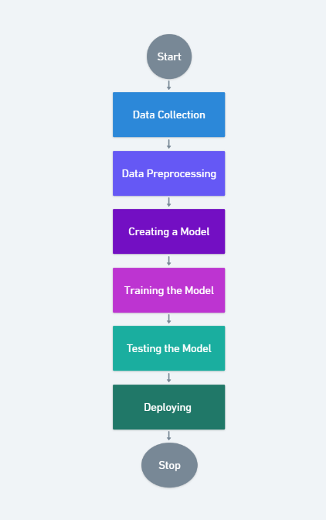
Project Flow Chart

Slide 8
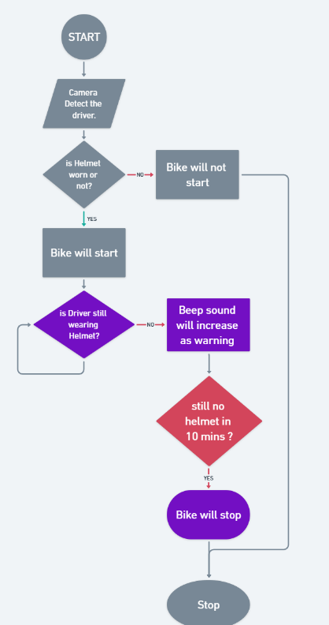
Model Flowchart

Slide 9
Research Methodologies
The research will be conducted using the following methodologies:
Literature Review: A comprehensive review of existing research on deep learning algorithms for traffic safety will be conducted.
Dataset Collection and Preprocessing: Large and diverse datasets for training and testing the model will be collected and preprocessed using Roboflow.
Model Development: The YOLOv11 model will be designed and implemented for object detection and recognition. The Ultralytics library will be used to integrate and facilitate the model training process.
Model Evaluation: The performance of the model will be evaluated using benchmark datasets and metrics.
Comparison: The performance of the YOLOv11 model will be compared with other state-of-the-art models for traffic safety.

Slide 10
Summary
Helmet Verify is an AI-powered system that ensures helmet compliance before and during bike operation using YOLOv11. It prevents the bike from starting without a helmet and triggers an alarm if the helmet is removed while riding. The system enhances road safety, law enforcement, and industrial compliance, with future scope in IoT and AI-based accident prevention. It achieves 98% precision and 90% recall, ensuring high detection accuracy in real-world conditions. The model is trained on 1,200 images and can be integrated with smart traffic systems for automated monitoring.

Slide 11
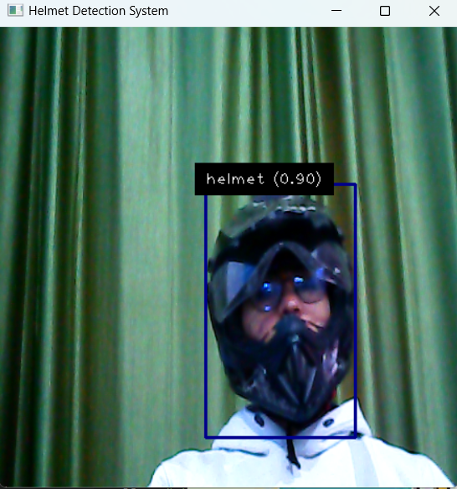
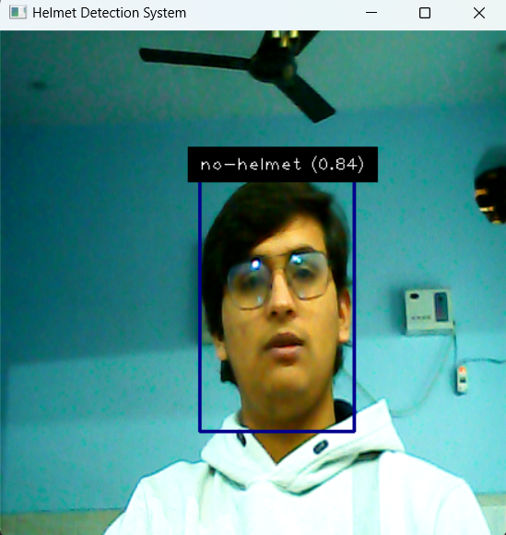
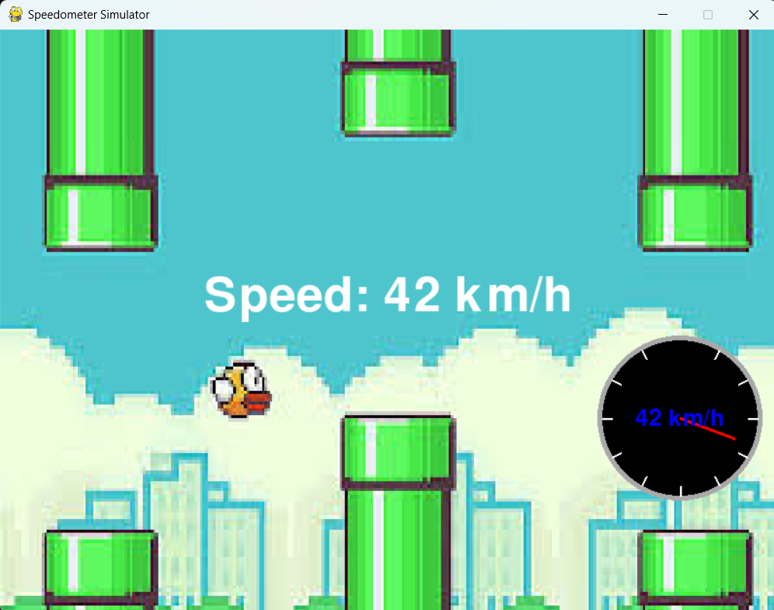

Slide 12
Utilization of Research
The findings of this research can be applied in:
Traffic Safety: Ensuring the safety of drivers and passengers.
Intelligent Transportation Systems: Enhancing the efficiency of transportation networks.
Smart Cities: Supporting advanced urban infrastructure.
The model can be integrated with existing traffic monitoring systems to improve safety measures.
This research can also:
Contribute to the development of new algorithms and techniques for object detection and recognition.
Advance applications in analyzing images and videos in real-time.

Slide 13
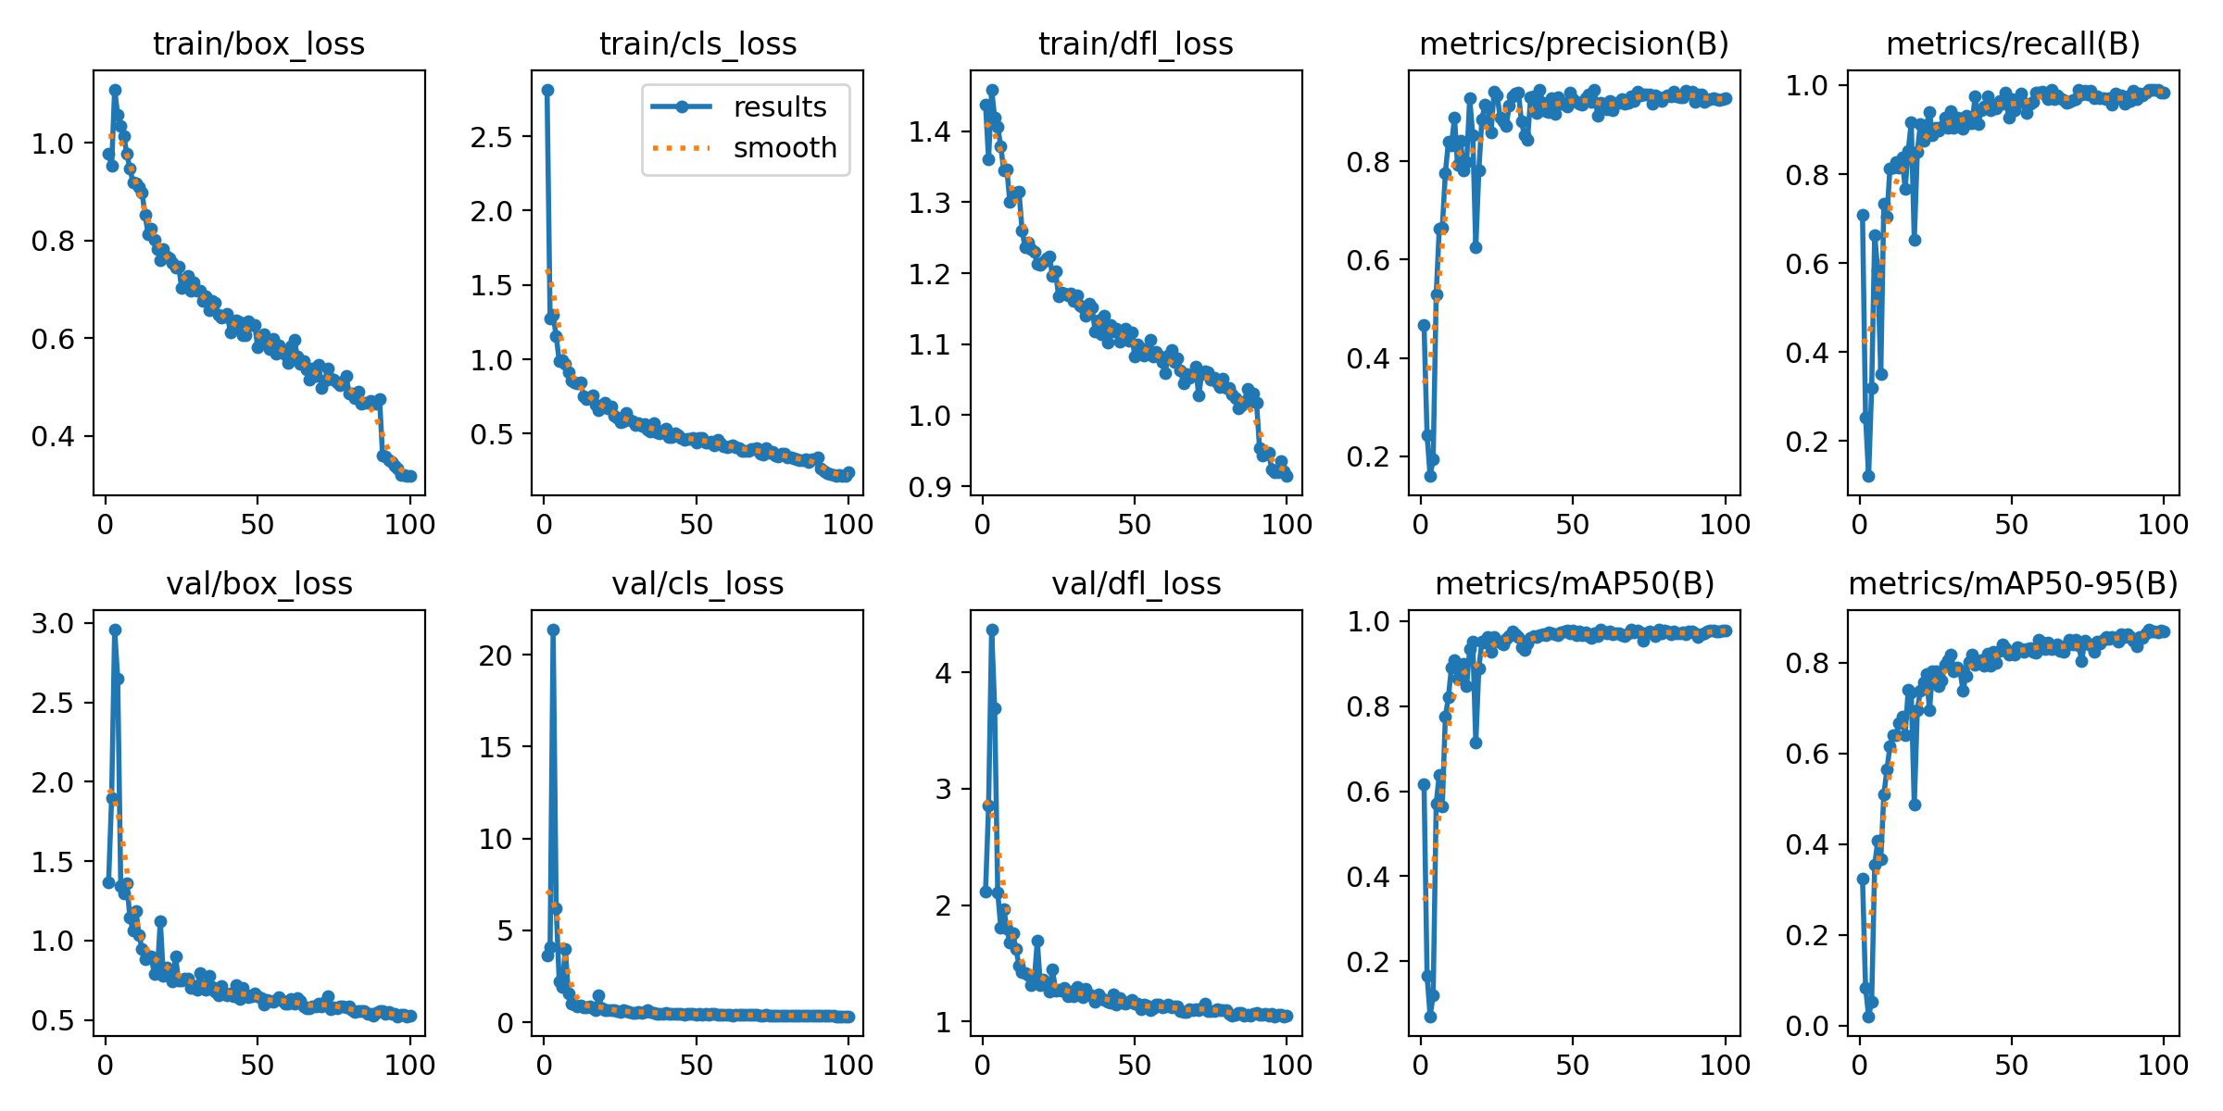
Result Analysis
98% precision for helmet detection
90% recall at maximum confidence
0.96 Overall F1-score across all classes
0.978 Mean Average Precision (mAP@0.5)

Slide 14
References
Real Time Automatic Detection of Motorcyclists With and Without a Safety Helmet
Author, F. : Article title. Journal 2 (5), 99–110 (2016).
Author, F., Author, S. : Title of a proceedings paper. In : Editor, F., Editor, S. (eds.) CONFERENCE 2016, LNCS, vol. 9999, pp. 1–13. Springer, Heidelberg (2016).
Author, F., Author, S., Author, T. : Book title. 2nd edn. Publisher, Location (1999).
Author, F. : Contribution title. In : 9th International Proceedings on Proceedings, pp. 1–2. Publisher, Location (2010).
LNCS Homepage, http://www.springer.com/lncs, last accessed 2016/11/21.

Slide 15
Team Member Details
Team Leader Name: Pratham Sherawat
Branch: Btech Stream: CSE - AI Year: IV
Team Member 1 Name: Aryan Barar
Branch: Btech Stream: CSE - AI Year: IV
Team Member 2 Name: Vivek Agarwal
Branch: Btech Stream: CSE - AI Year: IV

